Slide 1


PROJECT 1 - Currency Exchange Rate REVIEW
Steph Adey
Oliver James Uy
Kai Huang

Slide 2
Introduction
To develop an analytical tool that cater to individuals interested in forex trading, economic research, or financial market education
Financial Crisis Impact Assessment
Historical Trend Analysis
Real-time Currency Strength Analysis
Using the Exchange Rate API to get data resources
https://v6.exchangerate-api.com/v6/api-key

Slide 3
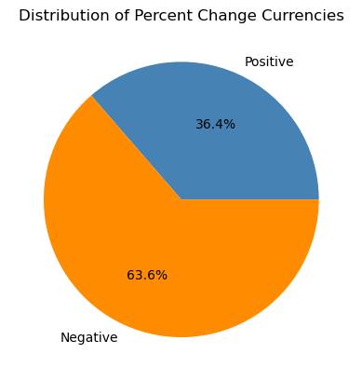
Exchange Rate Changes in 2008
There were 8 currencies with a positive percentage change and 14 currencies with a negative percentage change when AUD was the base currency.

Slide 4
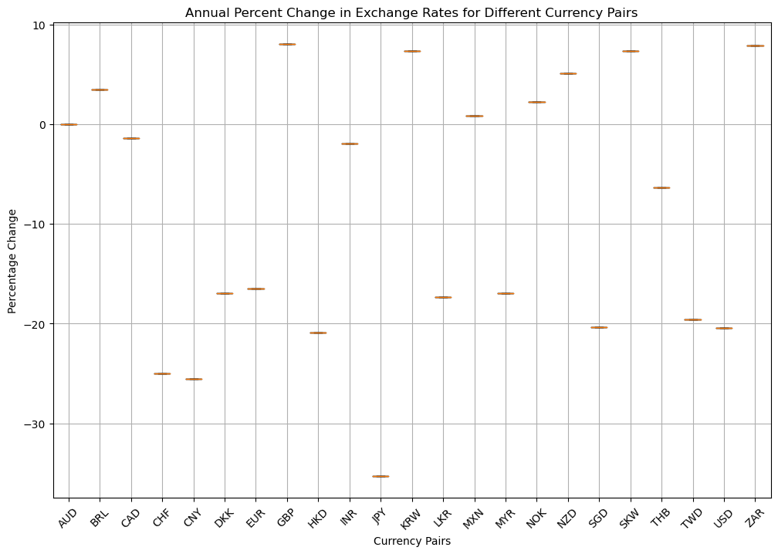
Top Performer and Worst Performer
The AUD-GBP currency pair was the top performer indicating strength in the AUD against this currency during this period.
The AUD-JPY currency pair was the worst performer indicating weakness in the AUD against this currency during this period.

Slide 5
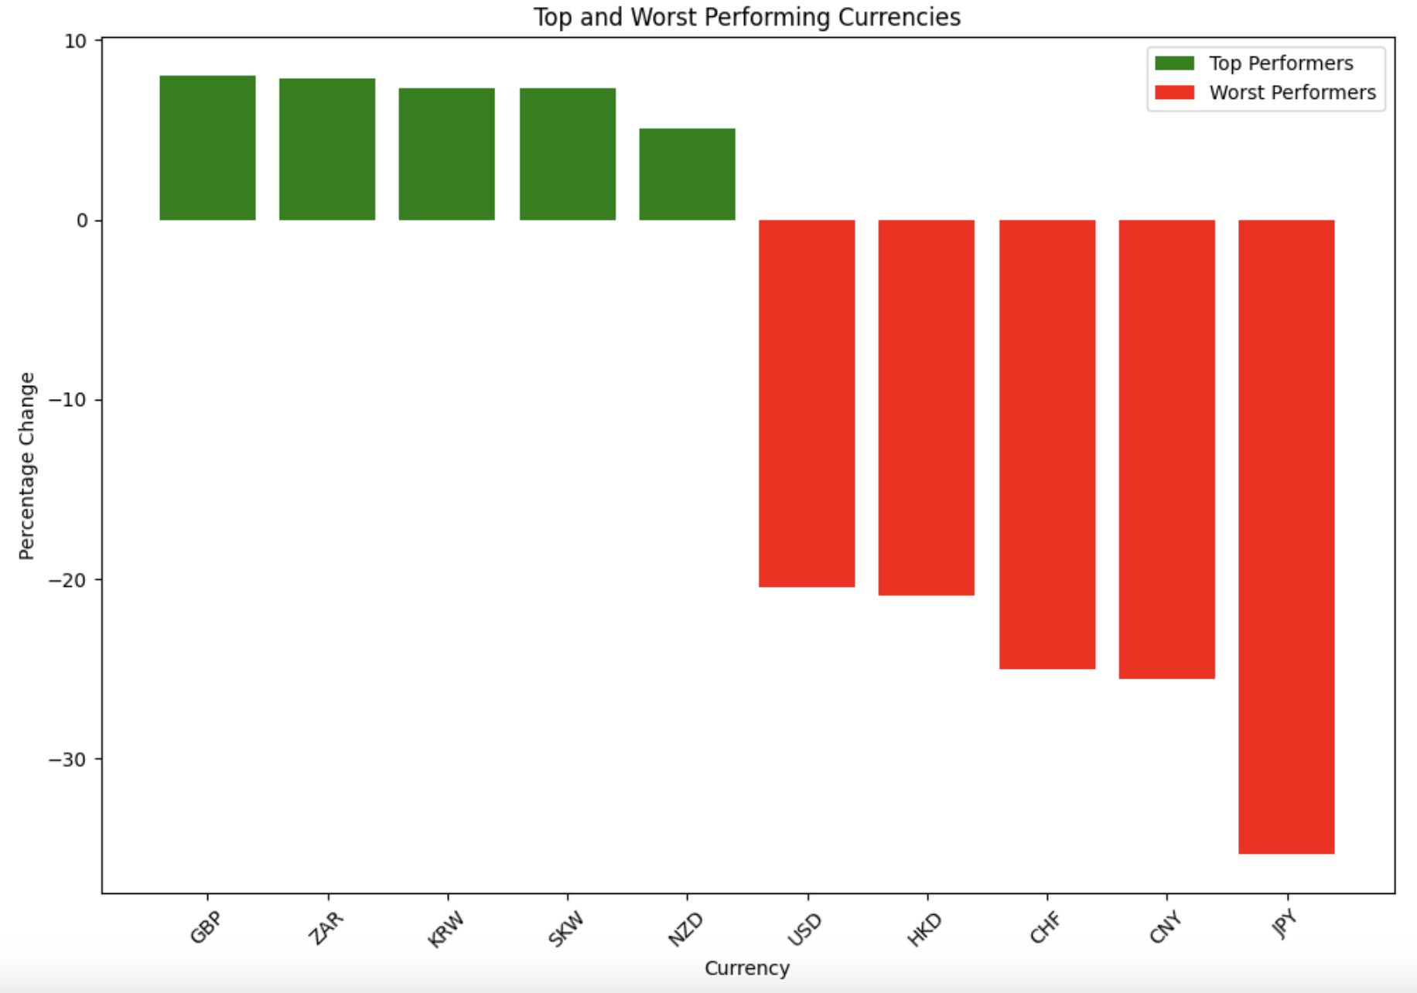
Major Currencies in the Worst Performers
JPY, CHF and USD were the Major currencies in the top 5 worst performers, indicating challenges against 3 major currencies during 2008 period.

Slide 6
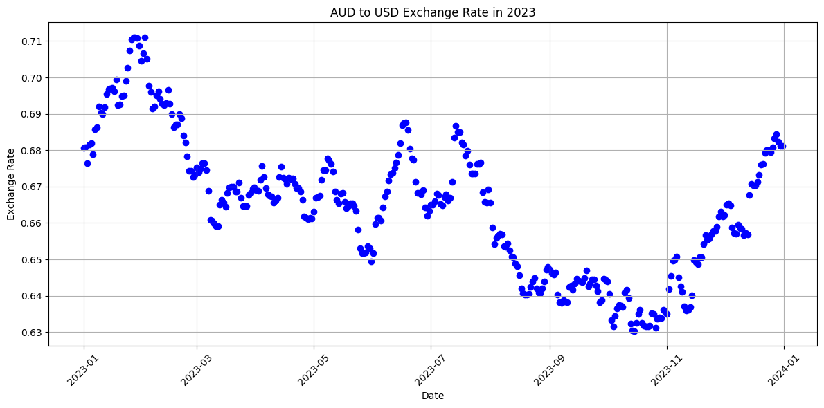
Performance of the Australian Dollar in 2023
By September 2023, AUD had reached a low point of 63.58 US cents, marking its lowest level in ten months, following a gradual decline in the preceding months

Slide 7
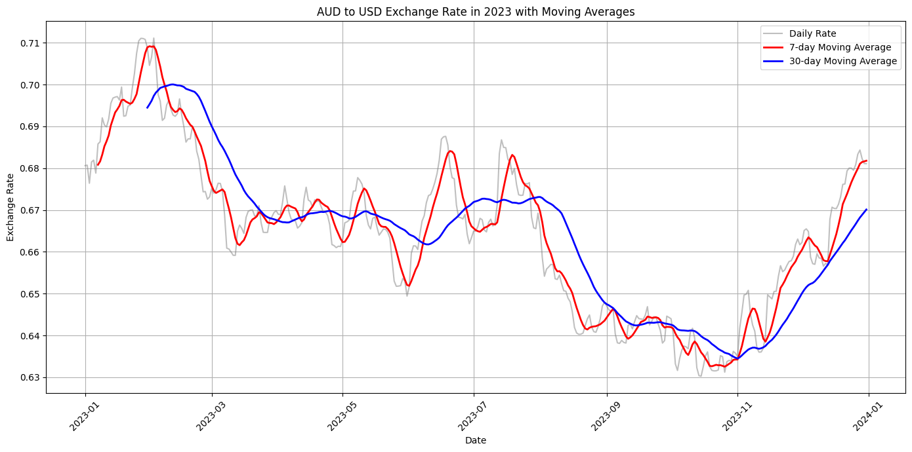
Performance of the Australian Dollar in 2023
The Australian dollar’s value is determined by the interplay of supply and demand in the foreign exchange market.

Slide 8
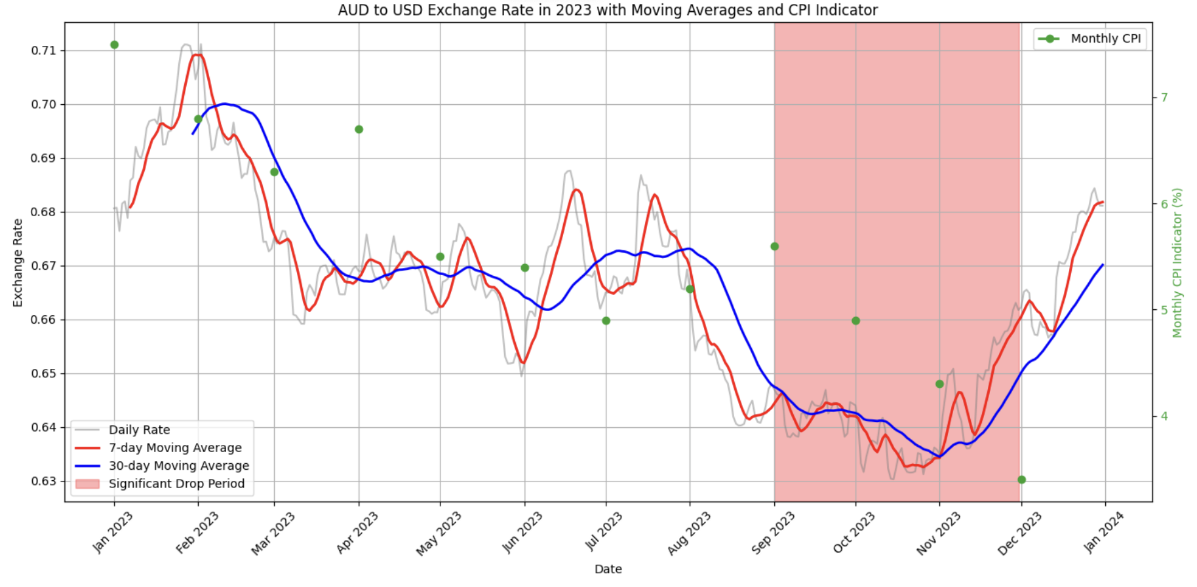
Performance of the Australian Dollar in 2023
The AUD has displayed a consistent decline, with sporadic upticks, over the course of the past year.
Interest rates and inflation figures play a pivotal role in shaping the AUD’s performance.

Slide 9
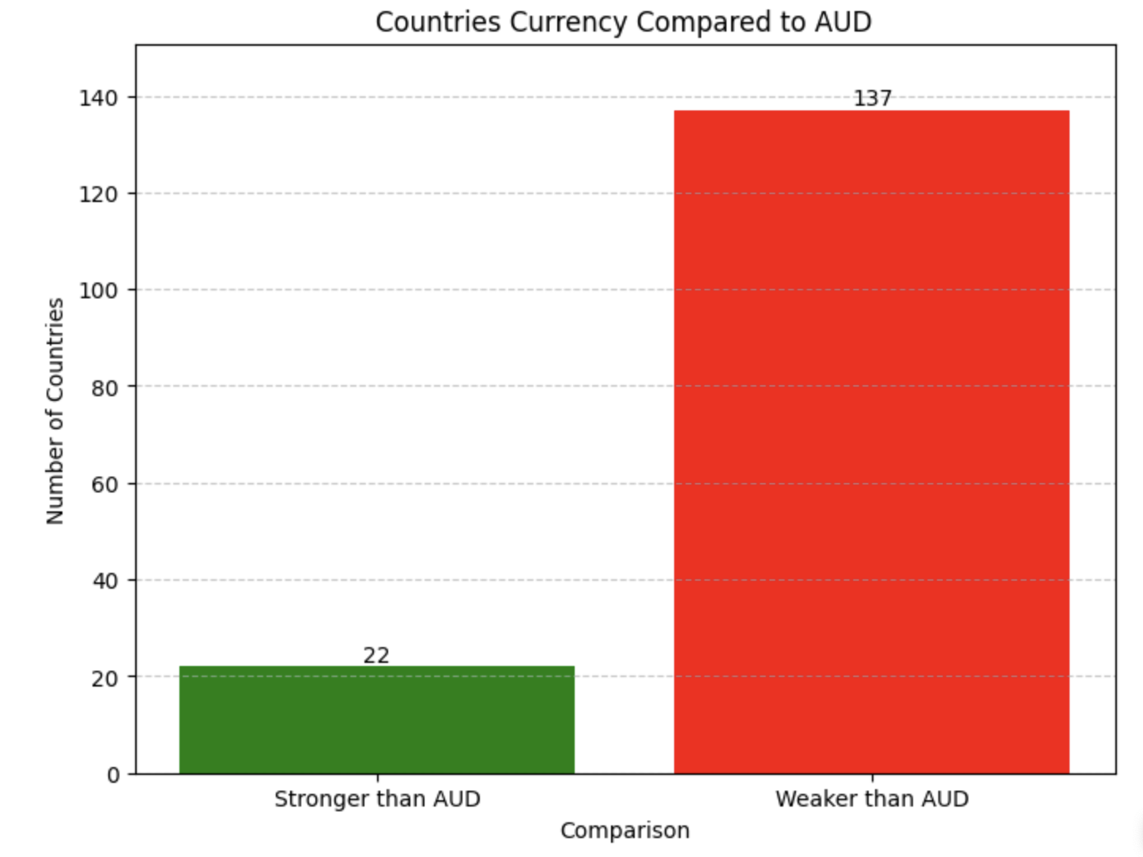
Real-time Currency Strength Analysis
There are 22 countries with currencies stronger than AUD and 137 countries with currencies weaker than AUD.
AUD is stronger than 85% of the world's currencies.

Slide 10
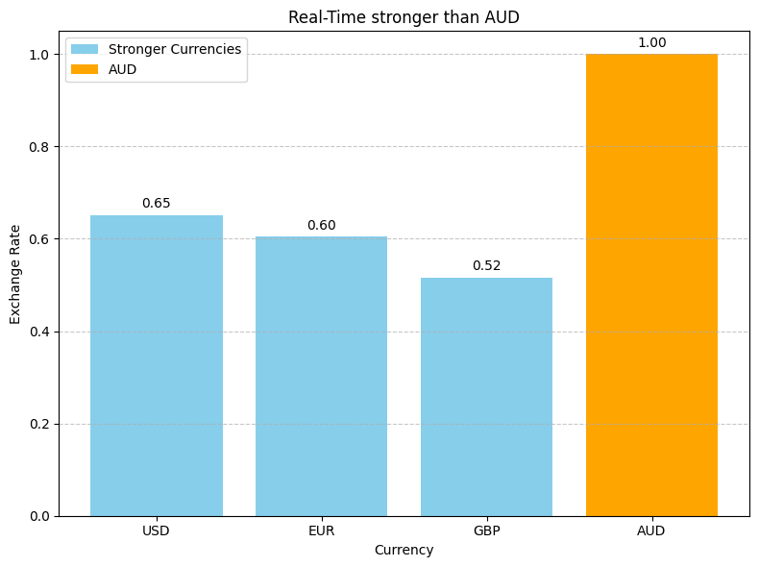
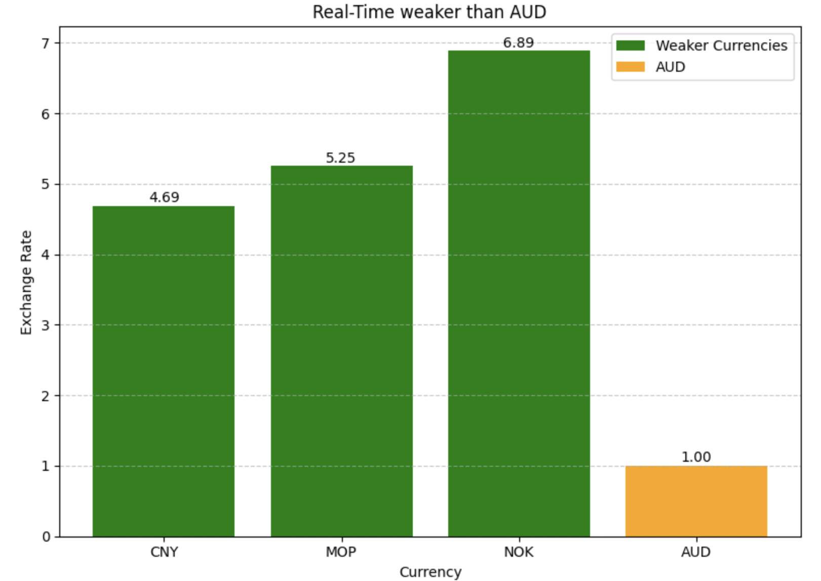
Real-time Currency Strength Analysis
The currency which has higher interest rate, such as USD, EUR, is stronger than AUD.
The currency which has lower interest rate, such as CNY, is weaker than AUD.

Slide 11


